Slide 1



RIS-Assisted 6G Networks: Challenges and Tradeoffs in Control Standardization
Ehsan Tohidi, Max Franke, André Drummond,
Stefan Schmid, Admela Jukan, and Slawomir Stańczak

Slide 2
Much research on RIS devices and physical properties, network-level studies rare. We need models for understanding performance and standards. What is unique here? And implications for control plane?
RIS-Assisted 6G Networks: Challenges and Tradeoffs in Control Standardization
Ehsan Tohidi, Max Franke, André Drummond,
Stefan Schmid, Admela Jukan, and Slawomir Stańczak

Slide 3
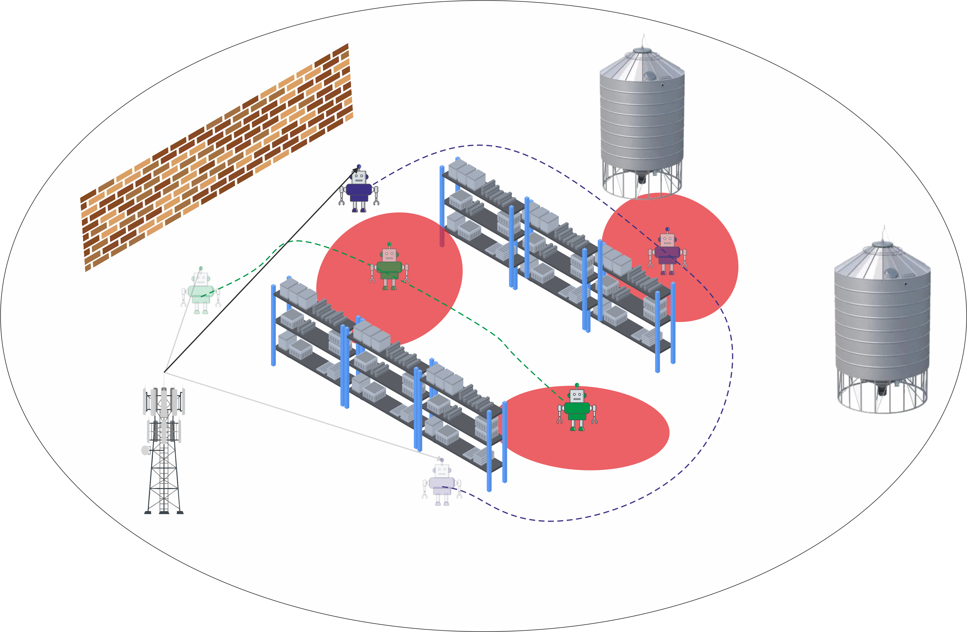
Campus Networks (e.g., Smart Factories)
Reliability Issue
E. Tohidi et al., "Reliability Assurance in RIS-Assisted 6G Campus Networks,"
20th International Conference on the Design of Reliable Communication Networks (DRCN), 2024.

Slide 4
Campus Networks (e.g., Smart Factories)
Reliability Issue
LoS blocking especially critical for mmWave and sub-THz!
E. Tohidi et al., "Reliability Assurance in RIS-Assisted 6G Campus Networks,"
20th International Conference on the Design of Reliable Communication Networks (DRCN), 2024.

Slide 5
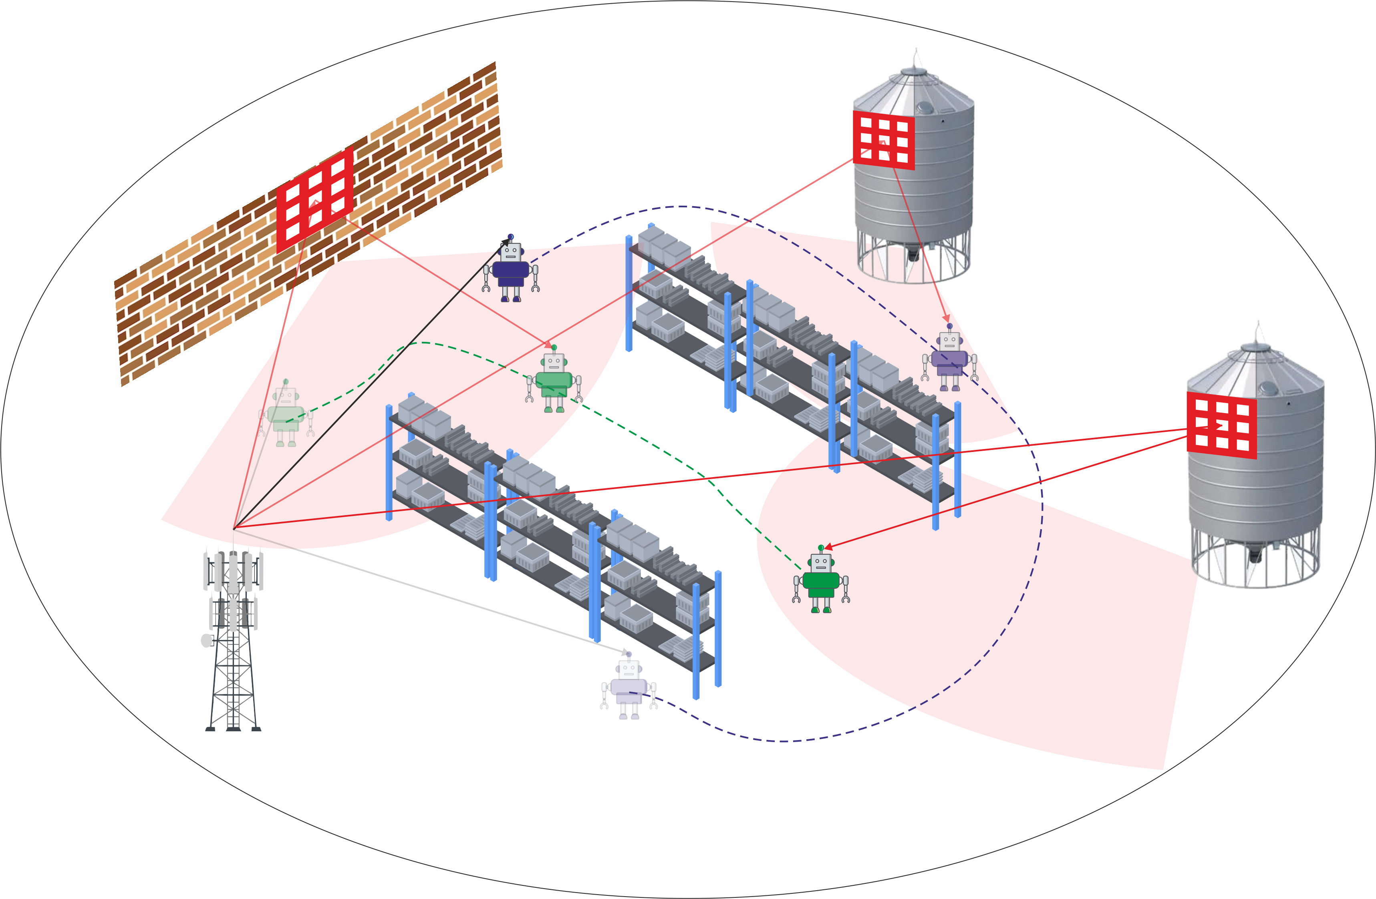
Campus Networks (e.g., Smart Factories)
Reliability Assurance: RIS
E. Tohidi et al., "Reliability Assurance in RIS-Assisted 6G Campus Networks,"
20th International Conference on the Design of Reliable Communication Networks (DRCN), 2024.

Slide 6
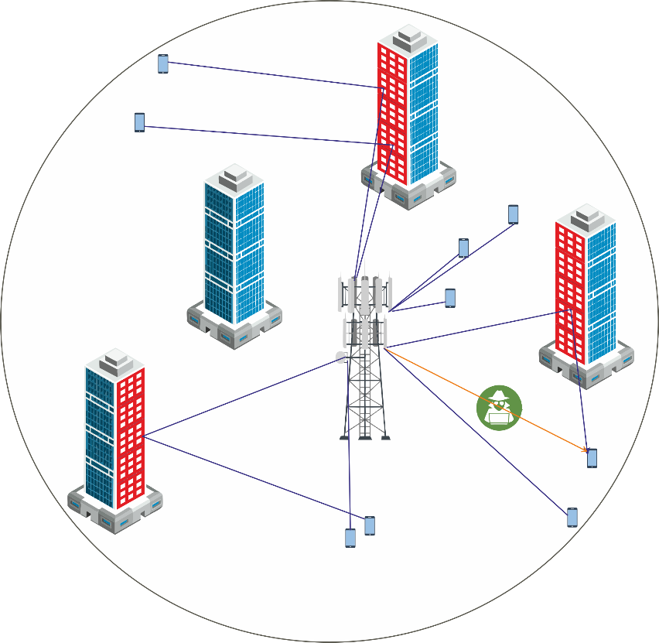

Introduction

Slide 7
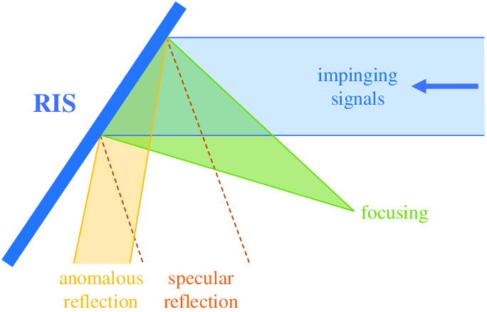
Introduction
What is a Reconfigurable Intelligent Surface?
Reconfigurable Intelligent Surface (RIS) is a planar surface comprising a large number of passive reflecting elements, each of which is able to induce a controllable phase change to the incident signal independently
Specular reflection to anomalous reflection
Advantages
Anomalous reflection - Reconfigurability
Disadvantage
Multiplicative fading due to cascaded channel
E. Tohidi et al., "Reliability Assurance in RIS-Assisted 6G Campus Networks,"
20th International Conference on the Design of Reliable Communication Networks (DRCN), 2024.

Slide 8
Introduction
What is a Reconfigurable Intelligent Surface?
Reconfigurable Intelligent Surface (RIS) is a planar surface comprising a large number of passive reflecting elements, each of which is able to induce a controllable phase change to the incident signal independently
Specular reflection to anomalous reflection
Aka „double path loss“
Advantages
Anomalous reflection - Reconfigurability
Disadvantage
Multiplicative fading due to cascaded channel
E. Tohidi et al., "Reliability Assurance in RIS-Assisted 6G Campus Networks,"
20th International Conference on the Design of Reliable Communication Networks (DRCN), 2024.

Slide 9
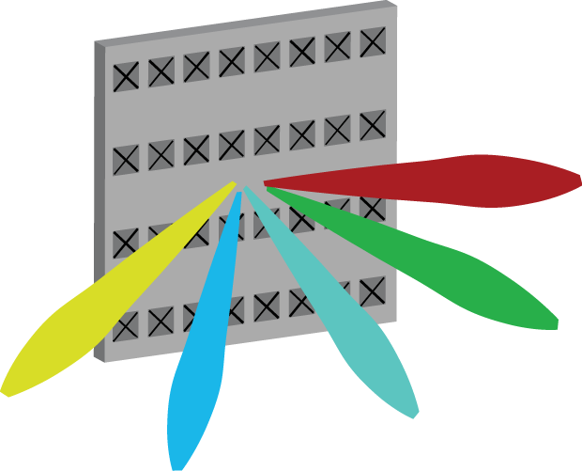
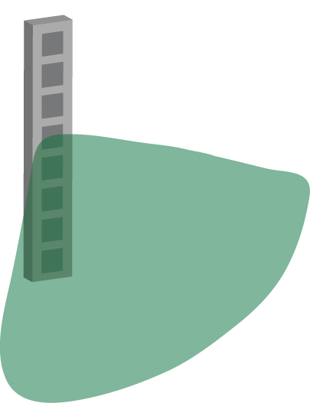

Key Technology for 6G?
5G: Adaptive multi-user beamforming
6G: Control objects in the environment?
?
1G-4G Sector antenna
Fixed radiation pattern
Unfortunate user
Fortunate user
credit: Emil Björnson

Slide 10

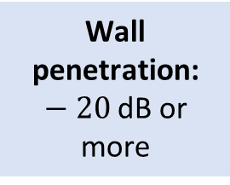
Key Technology for 6G?
Base station
Wall penetration: $−20$dB or more
Reflection
credit: Emil Björnson

Slide 11
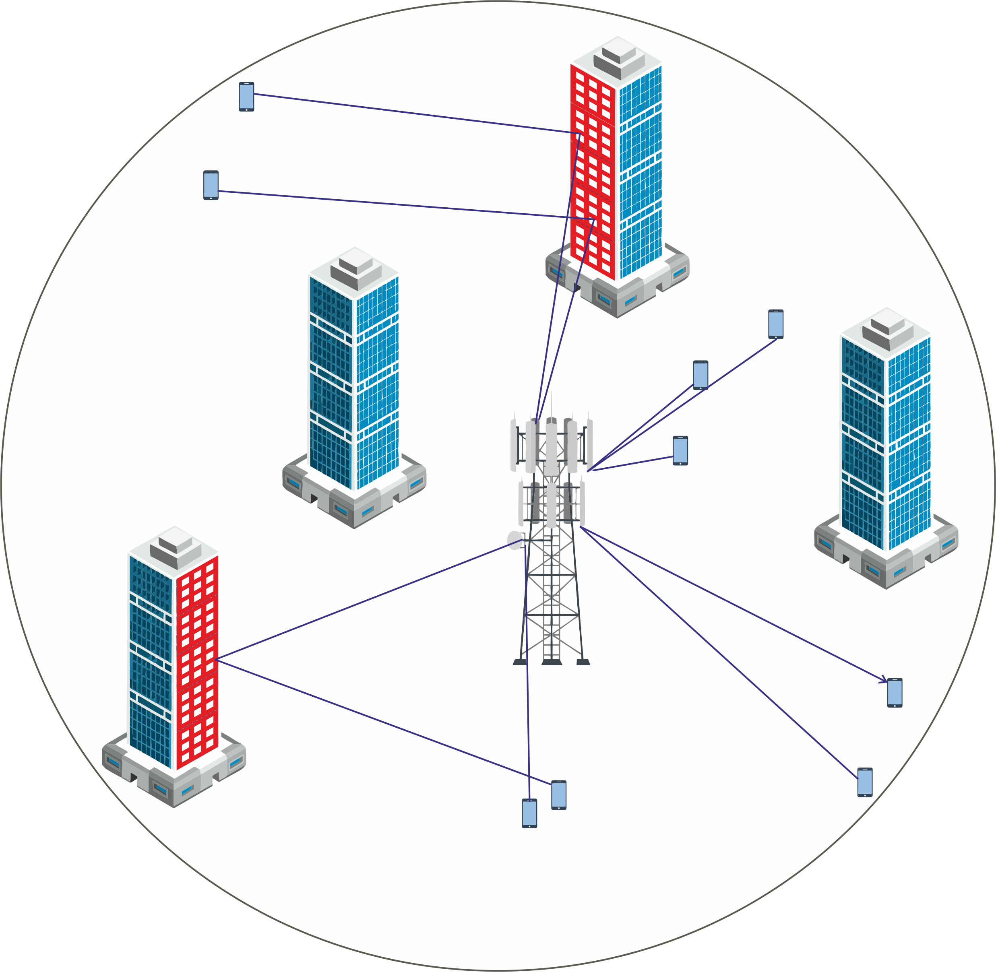
System Model
RIS-assisted wireless communication system
BS, multiple RISs, and several UEs
BS and RISs are static, while UEs can be static or mobile
Even BS-UE initial access may take time: requires alignment of directional antennas both at BS and UE (using beam sweeping, fixed codebooks).

Slide 12
RIS-ASSISTED LINK CHARACTERISTICS

Slide 13
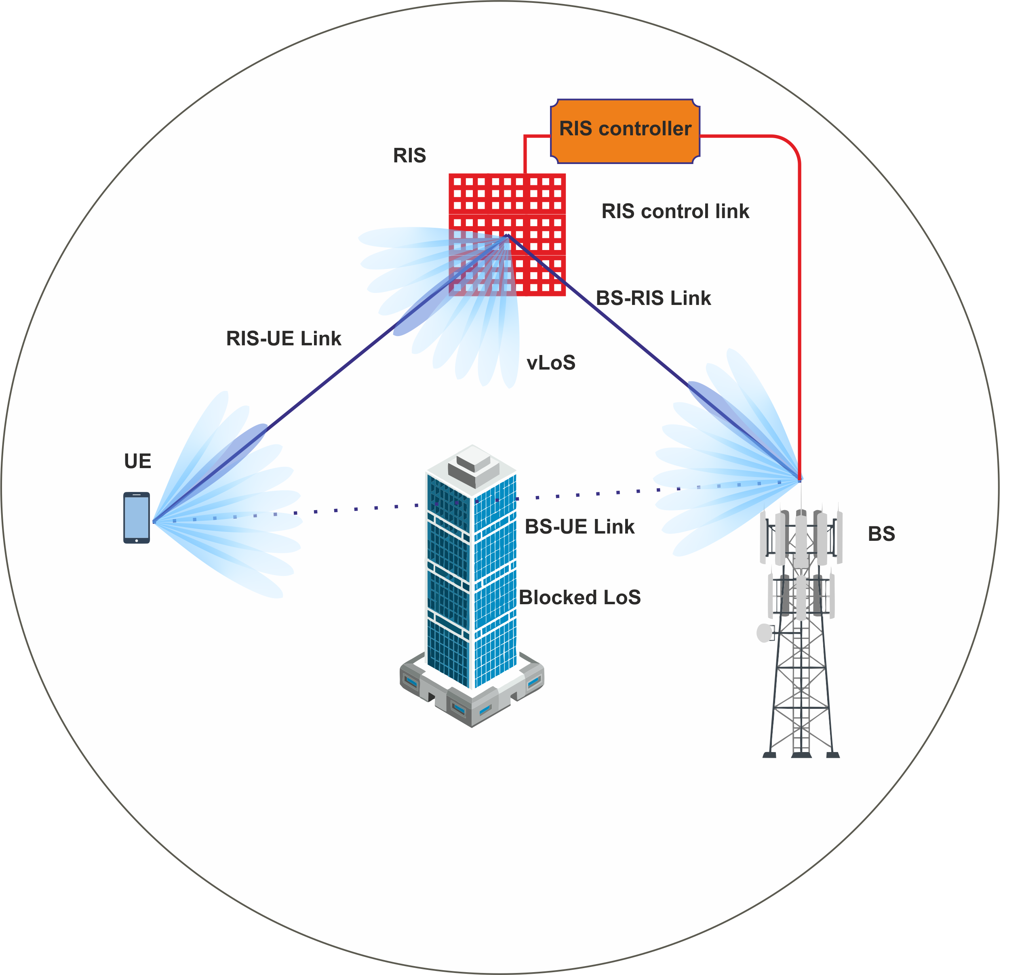
Cascaded Channel
Additional path loss
RIS-assisted link, consists of two concatenated links—commonly referred to as a cascade channel—namely the BS-RIS and RIS-UE links
This inherent characteristic of RIS-assisted systems results in lower overall channel gains than direct links.
Another key factor affecting the RIS-assisted channel gain is the RIS gain
The RIS ability to capture incident signal energy and redirect it toward the intended receiver
larger RIS surfaces yield higher RIS gain and, consequently, higher RIS-assisted channel gain.

Slide 14
Cascaded Channel
Additional path loss
RIS-assisted link, consists of two concatenated links—commonly referred to as a cascade channel—namely the BS-RIS and RIS-UE links
This inherent characteristic of RIS-assisted systems results in lower overall channel gains than direct links.
Another key factor affecting the RIS-assisted channel gain is the RIS gain
The RIS ability to capture incident signal energy and redirect it toward the intended receiver
larger RIS surfaces yield higher RIS gain and, consequently, higher RIS-assisted channel gain.
Other factors matter, e.g., when located in near-field. Our focus here however far-field (each RIS serves one UE at a time).

Slide 15
Reconfiguration Time
Critical and Non-negligible
RIS can perform beamforming by dynamically altering the phases of the reflected waves.
Various technologies, each with its cost, energy consumption, and response time characteristics
Varactor diodes and PIN diodes, can achieve reconfiguration times in the range of a few nanoseconds
Liquid crystals (LC), have reconfiguration times that can extend beyond ten milliseconds
LC technology offers advantages such as cost-effectiveness, scalability, low energy consumption, and the ability to provide continuous phase shifting.
Relatively longer reconfiguration time associated with LC highlights the importance of carefully considering this factor in practical deployments.

Slide 16
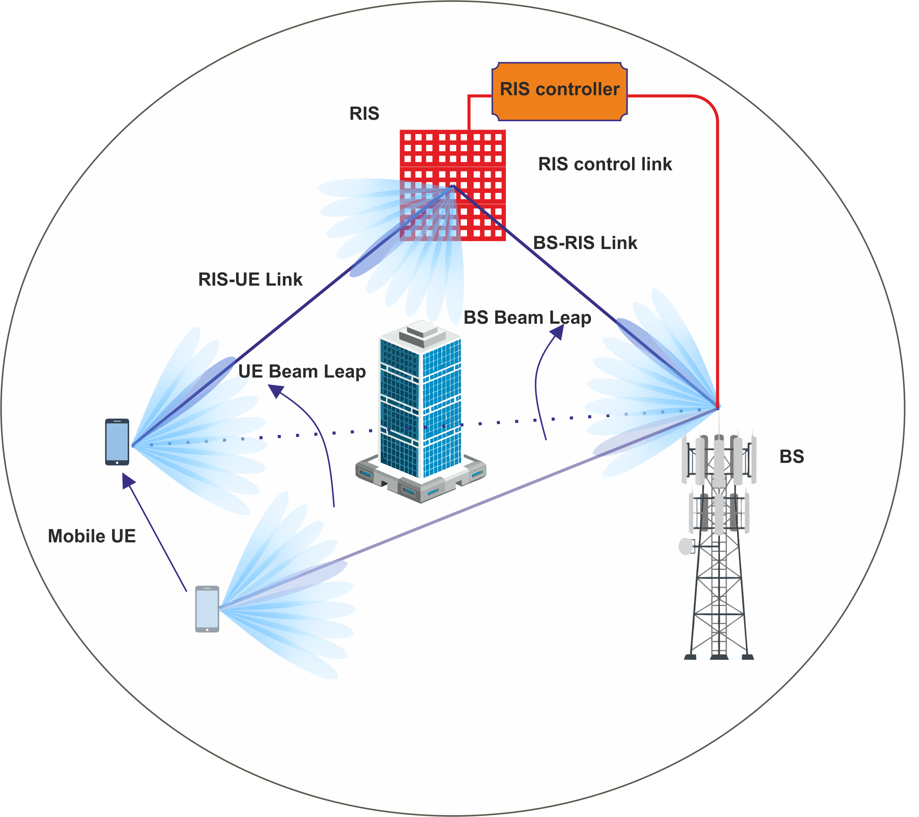
Beam Leap While Tracking
Sudden shift in the required beam direction
In a mobile UE scenario, due to the movement of the UE, the device currently served via a RIS-assisted link may enter a blind spot of the RIS
BS may be able to serve the UE directly if the direct linkis no longer blocked at the new location
the system may need to switch to another RIS that can provide coverage in the UE’s new location
the next beam selected by the BS will likely be significantly different from the current one, as it may need to point in a completely different direction
Starkly contrasts conventional tracking methods, where beam sweeping typically occurs within neighboring beams to account for small movements of the UE.

Slide 17
Beam Leap While Tracking
Sudden shift in the required beam direction
In a mobile UE scenario, due to the movement of the UE, the device currently served via a RIS-assisted link may enter a blind spot of the RIS
BS may be able to serve the UE directly if the direct linkis no longer blocked at the new location
the system may need to switch to another RIS that can provide coverage in the UE’s new location
the next beam selected by the BS will likely be significantly different from the current one, as it may need to point in a completely different direction
Starkly contrasts conventional tracking methods, where beam sweeping typically occurs within neighboring beams to account for small movements of the UE.
Another new aspect! Requires beam jump/leap procedure.

Slide 18
CONTROL PLANE ASPECTS: Use Cases

Slide 19
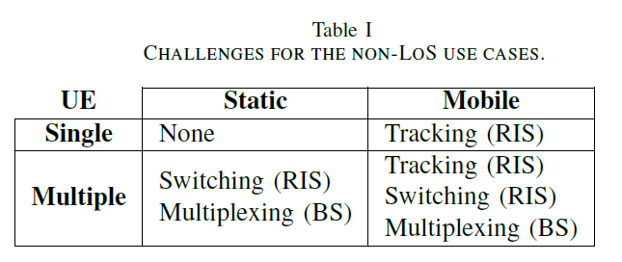
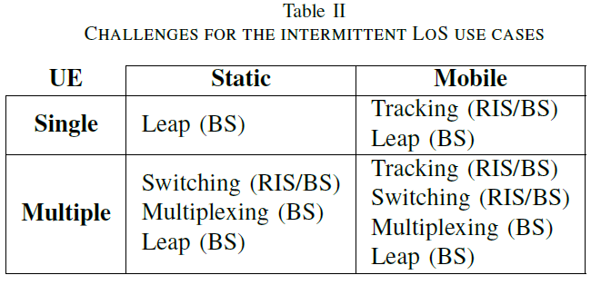
Scenarios and Challenges for Control Plane
Depending on Use Case

Slide 20
CONTROL PLANE ASPECTS: Proposed RIS Control

Slide 21
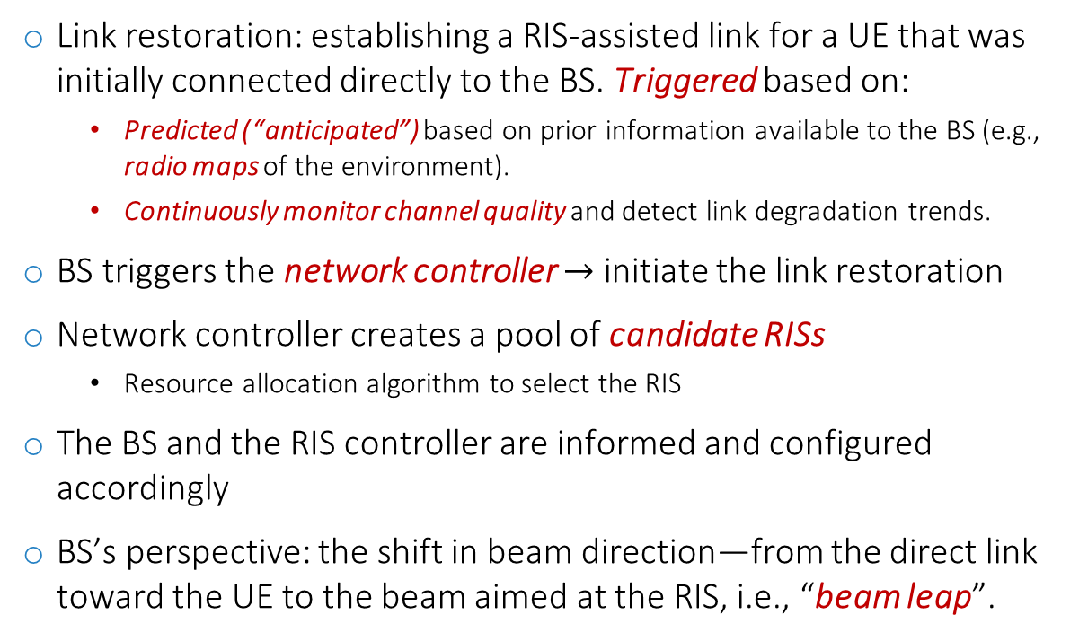
Proposed RIS Control
RIS-assisted Link Restoration Procedure
Link restoration: establishing a RIS-assisted link for a UE that was initially connected directly to the BS. Triggered based on:
Predicted (“anticipated”) based on prior information available to the BS (e.g., radio maps of the environment).
Continuously monitor channel quality and detect link degradation trends.
BS triggers the network controller $→$ initiate the link restoration
Network controller creates a pool of candidate RISs
Resource allocation algorithm to select the RIS
The BS and the RIS controller are informed and configured accordingly
BS’s perspective: the shift in beam direction—from the direct link toward the UE to the beam aimed at the RIS, i.e., “beam leap”.

Slide 22
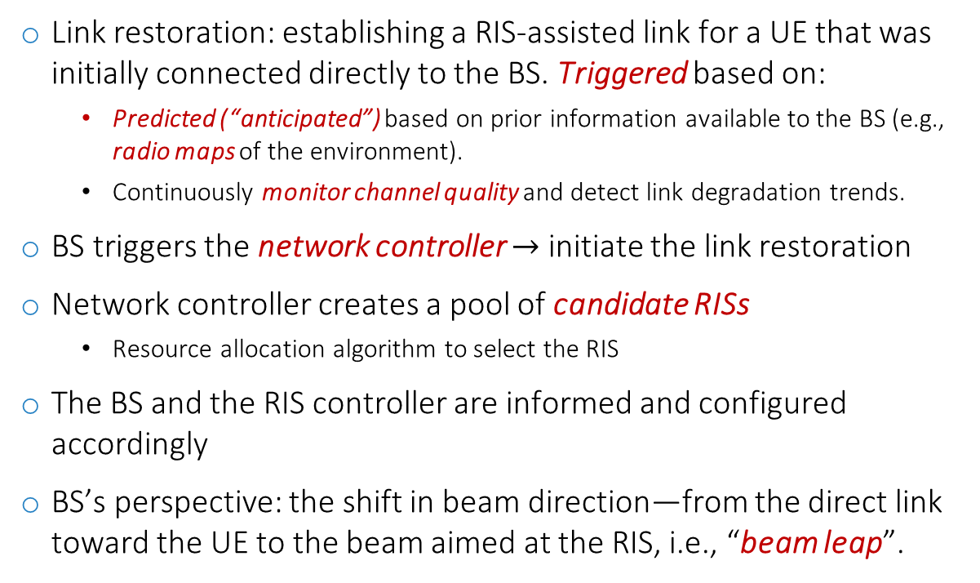
Proposed RIS Control
RIS-assisted Link Restoration Procedure
Triggered by the BS.
Link restoration: establishing a RIS-assisted link for a UE that was initially connected directly to the BS. Triggered based on:
Predicted (“anticipated”) based on prior information available to the BS (e.g., radio maps of the environment).
Continuously monitor channel quality and detect link degradation trends.
BS triggers the network controller $→$ initiate the link restoration
Network controller creates a pool of candidate RISs
Resource allocation algorithm to select the RIS
The BS and the RIS controller are informed and configured accordingly
BS’s perspective: the shift in beam direction—from the direct link toward the UE to the beam aimed at the RIS, i.e., “beam leap”.
Could also require handover (new BS): not considered here.
Depending on demand, available resources, priority…
Accuracy depends on time elapsed since last connection, mobility speed, etc.

Slide 23
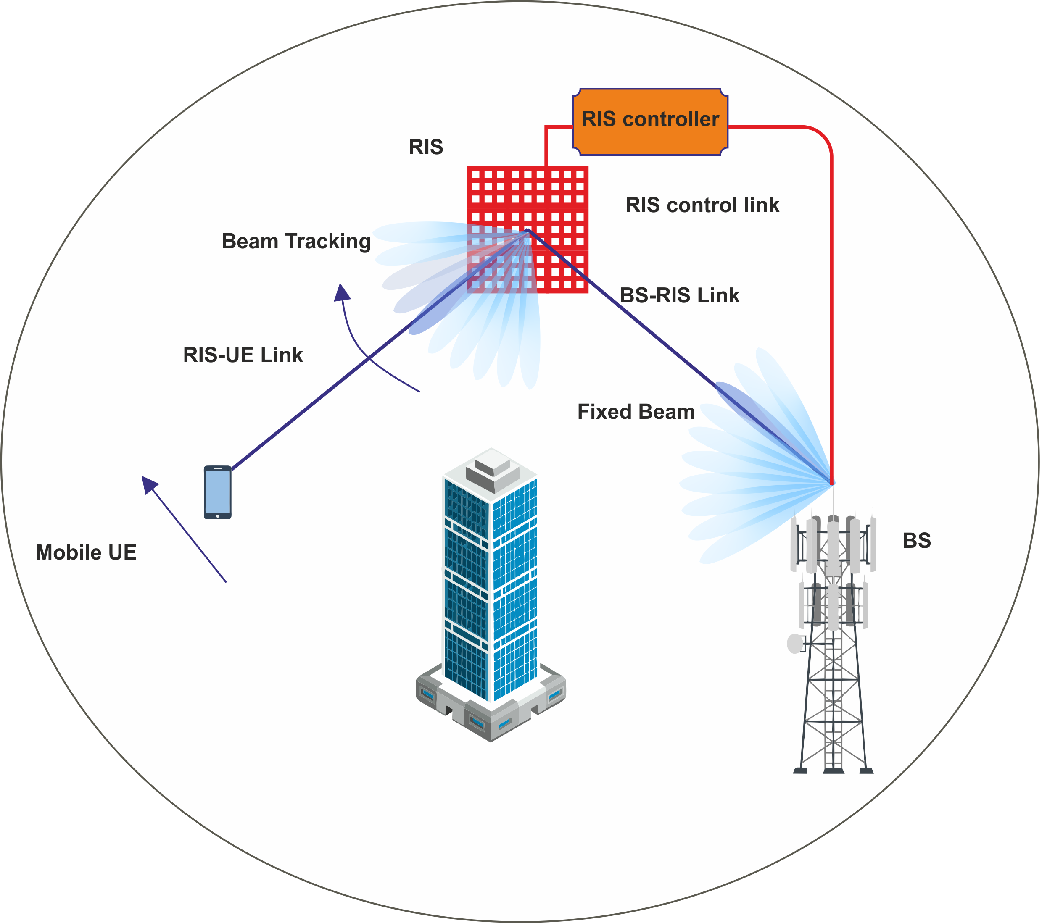
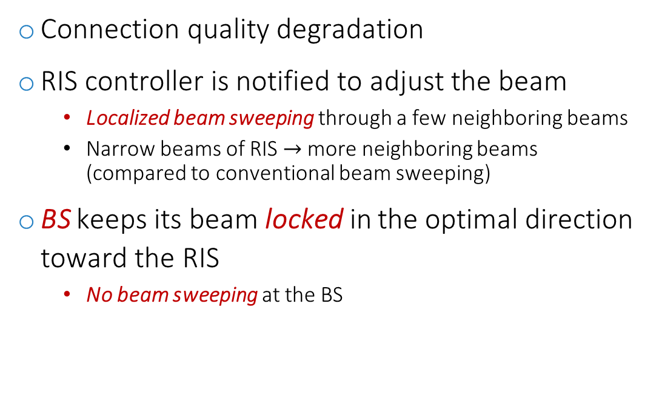
Proposed RIS Control
Beam-Tracking in RIS-assisted Link
Connection quality degradation
RIS controller is notified to adjust the beam
Localized beam sweeping through a few neighboring beams
Narrow beams of RIS $→$ more neighboring beams (compared to conventional beam sweeping)
BS keeps its beam locked in the optimal direction toward the RIS
No beam sweeping at the BS

Slide 24
Proposed RIS Control
Beam-Tracking in RIS-assisted Link
Connection quality degradation
RIS controller is notified to adjust the beam
Localized beam sweeping through a few neighboring beams
Narrow beams of RIS $→$ more neighboring beams (compared to conventional beam sweeping)
BS keeps its beam locked in the optimal direction toward the RIS
No beam sweeping at the BS
RIS: localized sweep compared to BS!
Due to larger surface, RIS beams are narrower than BS‘ beams.
BS can lock beam: same RIS.

Slide 25
Proposed RIS Control
Try BS-Direct link
BS will attempt to re-establish a direct link whenever possible
transition from the RIS-assisted link to a direct BS-UE
This direction is less critical than restoration: improves quality.

Slide 26
Proposed RIS Control
Keep Connection during Intermittent LoS Connection
Frequent changes in connection status—between LoS and non-line-of-sight (nLoS)—within short time intervals complicate transitions.
This rapid fluctuation in connection quality can lead to connection loss, as the link may not be re-established within the limited available time.
Proposed solution: maintain the previous connection for a short duration until the new connection is established.

Slide 27
Proposed RIS Control
Link Backup – Multi connectivity
Abrupt channel behavior in high frequency, e.g., terahertz
Link backup strategy
Candidate RIS reserved for potential abrupt disconnections
The problem of over allocation (not scalable)
Multiconnectivity
Provide multiple links simultaneously
Seamless switch to the new link
Price: requires more resources!

Slide 28
RIS-ASSISTED 6G NETWORKS

Slide 29
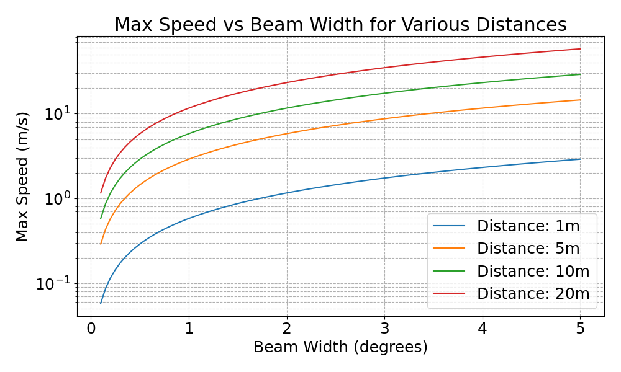
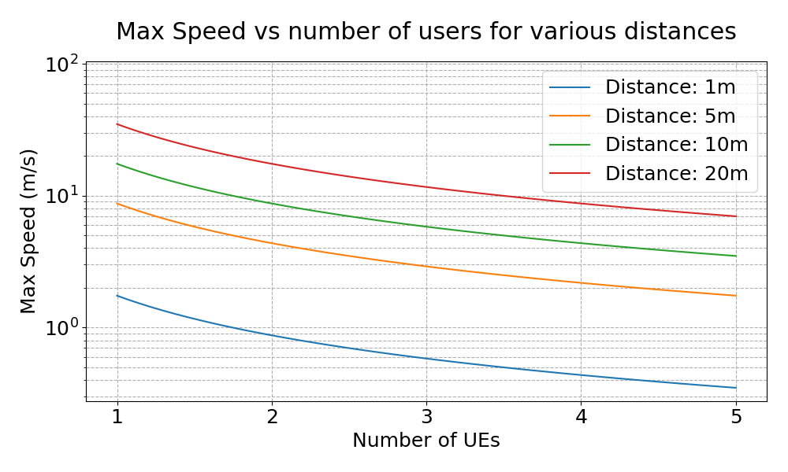
RIS-ASSISTED 6G NETWORKS
RIS in Practice
Simplified model (optimistic): max speed an UE can move is limited by reconfiguration time and #UEs
RIS reconfiguration time assumed to be 10 ms
5G and beyond standards in handover interruption time

Slide 30
RIS-ASSISTED 6G NETWORKS
RIS in Practice
Simplified model (optimistic): max speed an UE can move is limited by reconfiguration time and #UEs
RIS reconfiguration time assumed to be 10 ms
5G and beyond standards in handover interruption time
Delay due to switching between users.
Typical values for indoor. For outdoor, less well suited?

Slide 31
Summary
RIS promising but not much literature on link level studies yet
Reality is complex: call to community to conduct more research on realistic models and prototypes
A prerequisite for standardization

Slide 32
Thank you! Questions?

